Slide 1


MAADHAV AUTOMOTIVE
FASTENERS PVT. LTD.
Product Manual
GROOVING MACHINE 02
(Electrical Renewal Project)
Done By
MAINTICS AUTOMATION & ROBOTICS LLP

Slide 2
Table Of Contents
Operation Manual
Electrical Drawing
Troubleshooting Guide
BOM (Bill of Material)

Slide 3
Operation Manual

Slide 4

Company Profile Screen
At first when you turn on the Machine this screen will open.
This is the Company Introduction screen.
Click anywhere in the screen to navigate on Main Menu

Slide 5
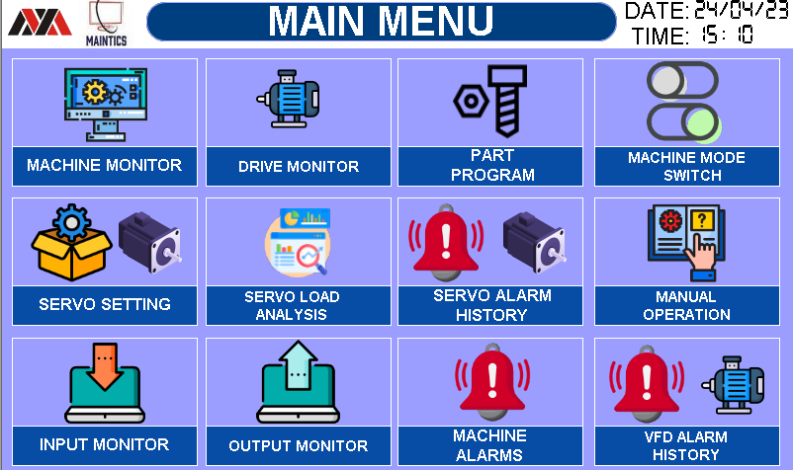
1. MAIN MENU SCREEN
This Screen is for Navigation inside the HMI of below screens.
Below are the list of all available screen in the HMI.
MACHINE MONITOR
DRIVE MONITOR
PART PROGRAM
MACHINE MODE SWITCH
SERVO SETTING
SERVO LOAD ANALYSIS
SERVO ALARM HISTORY
MANUAL OPERATION
INPUT MONITOR
OUTPUT MONITOR
MACHINE ALARMS
VFD ALARMS HISTORY

Slide 6
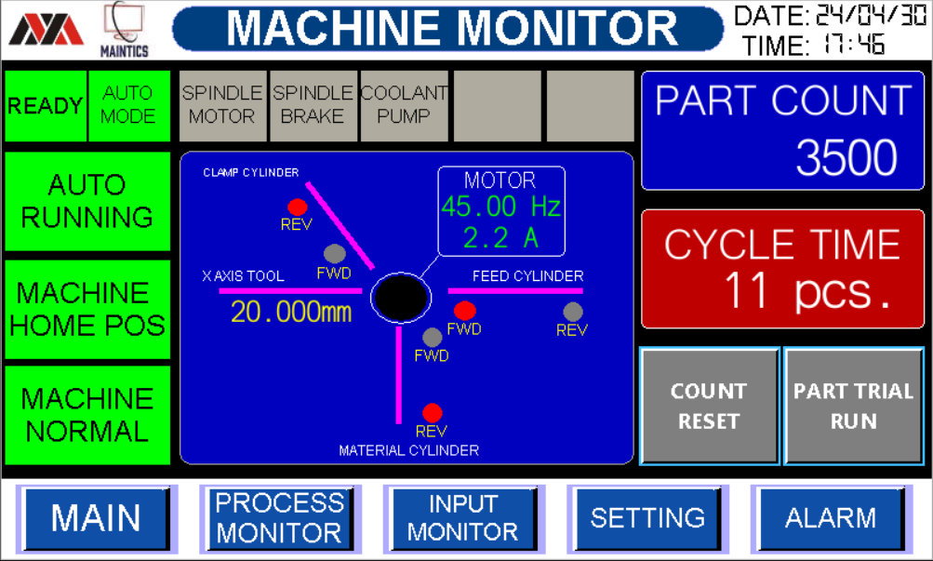












2. PROCESS MONITOR SCREEN
This screen is to Monitor Whole machine at Single Place
Machine Ready Status
Machine Auto / Manual Mode Status
Machine Auto Running Status
Device Running Status
Home Position Indication and Fault Indication
Not Ready
Ready
Manual Mode
Auto Mode
Machine Stopped
Auto Running
Device OFF
Device Running
Not at Home
Machine at Home
Normal
Fault

Slide 7
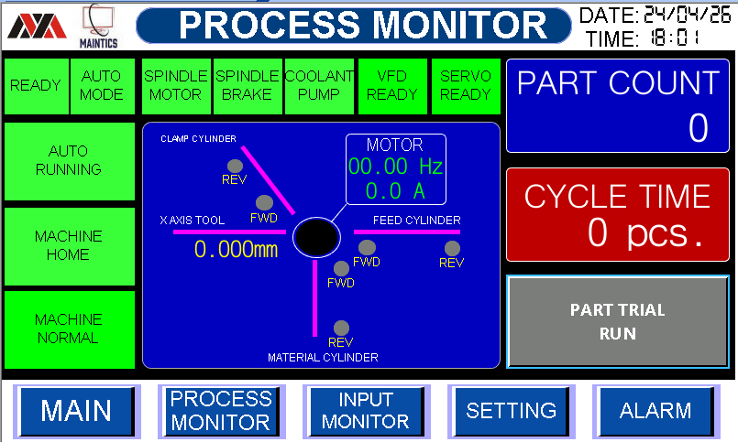


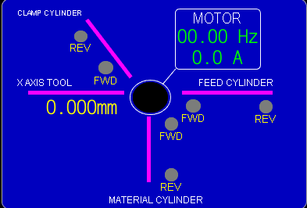
2. PROCESS MONITOR SCREEN
This screen is to Monitor Whole machine at Single Place
6. Total Parts count Cumulative and Cycle time Parts/min.
7. Machine Inputs Monitoring (Cylinder Reed switch)
8. Navigation Bar
Here you can monitor all reed switch condition On or Off.
Feed Cylinder
Material Cylinder
Clamp Cylinder
X Axis Cylinder
Y Axis Cylinder
SPINDLE MOTOR STATUS
Used to easily navigate from one screen to another screen

Slide 8
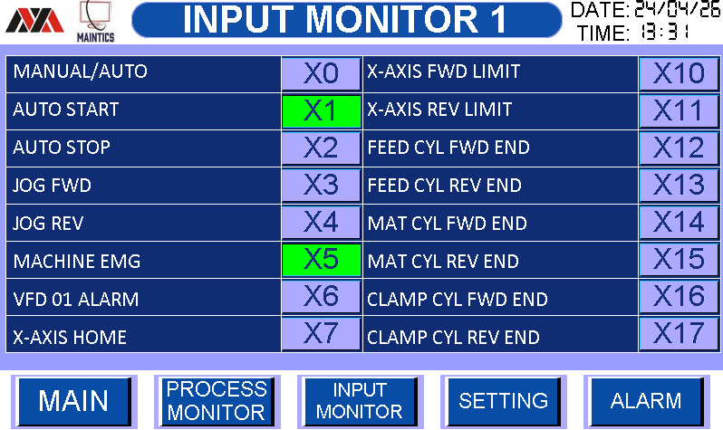



3.INPUT MONITOR SCREEN
This screen is to monitor all PLC Inputs total 16 Nos.
1. All inputs status from Off to On is as below
INPUT OFF
INPUT ON
MACHINE EMARGENCY PRESSED
MACHINE EMARGENCY NOT PRRESSED

Slide 9
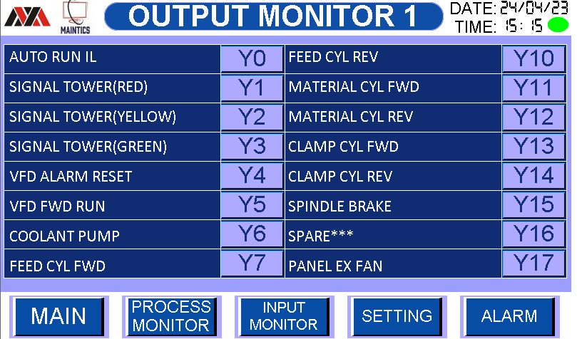


4. OUTPUT MONITOR SCREEN
This screen is to monitor all PLC Outputs total 16Nos.
1. All Output status from Off to On is as below
OFF
ON

Slide 10
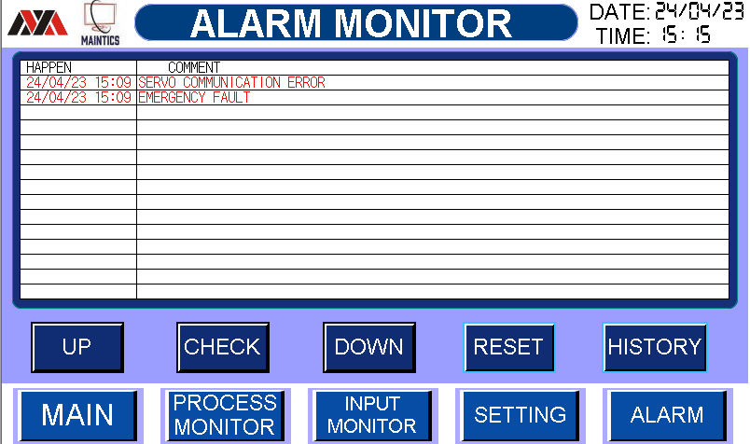



5. ALARM MONITOR SCREEN
This screen is used to monitor machine current alarms
Alarm screen navigation buttons
Reset button to reset current Alarms
Alarm History Screen access Button

Slide 11
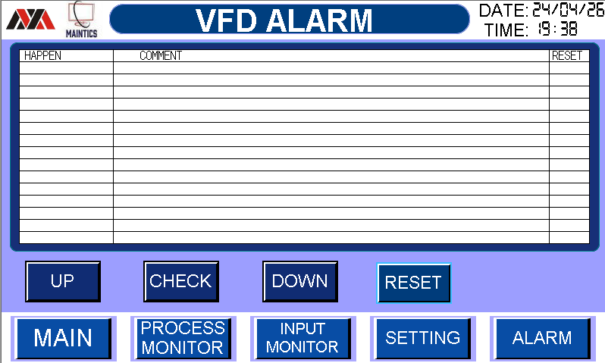
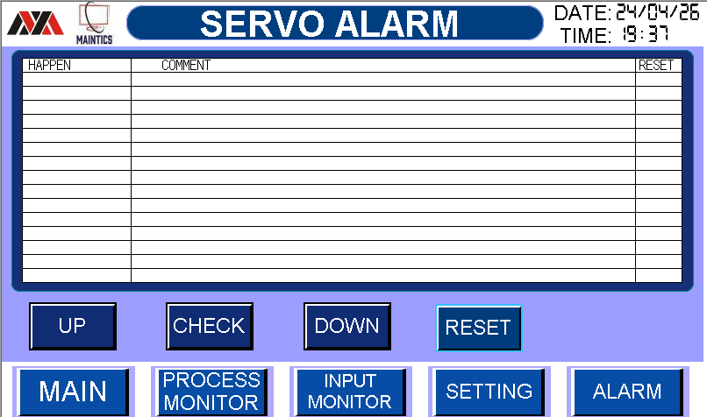
5. ALARM HISTORY SCREEN
This screen is used to monitor machine current alarms
Alarm screen navigation buttons

Slide 12
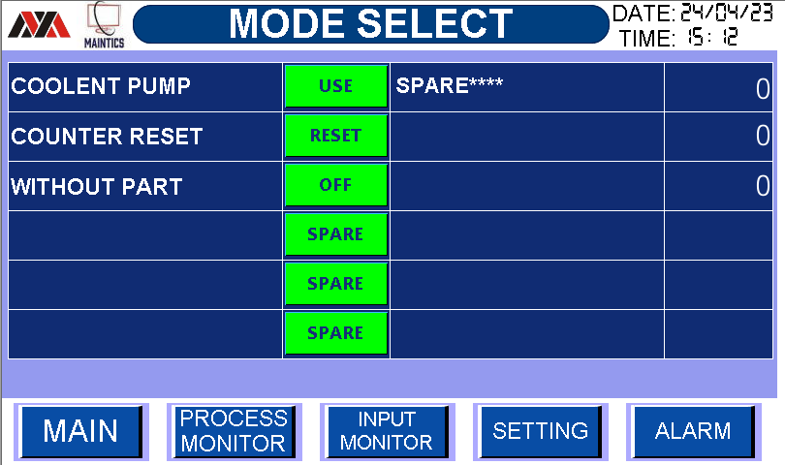
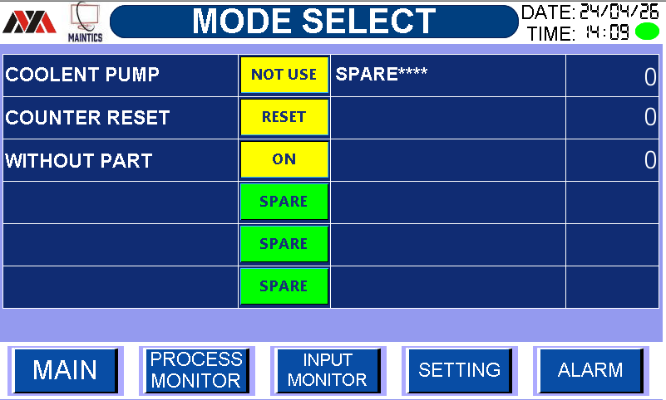





6. MODE SELECT SETTING SCREEN
Machine Settings can be done from this screen.
COOLENT PUMP USE
2. COOLENT PUMP NOT USE
3. COUNTER RESET
WITHOUT PART OFF
WITHOUT PART ON

Slide 13
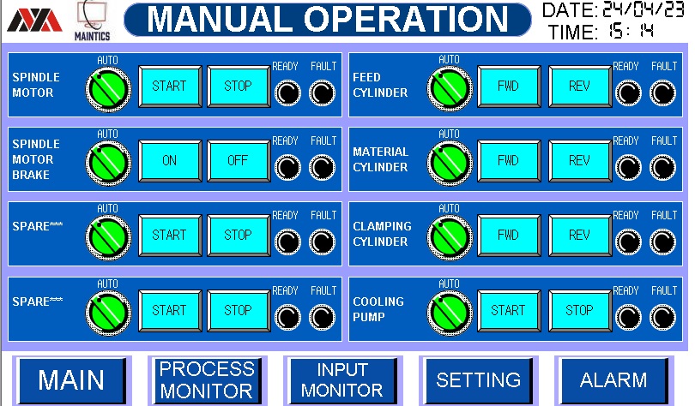

7. MANUAL OPEARTION 1 SCREEN
Manual Operation of all device can be performed using this screen
Steps for manual operation
First check Fault Light it should be Off
Now check Ready Light it should be Green
Now press Auto Manual selector switch to change mode from Auto to manual
Now Press Start Button to Start the Device
It will glow green if device is started.

Slide 14
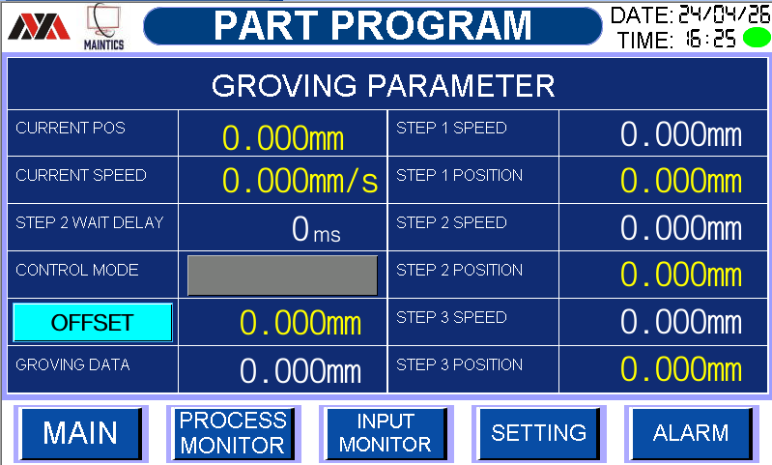






8. PART PROGRAM SCREEN
Here you can change grooving Program
STEP 2WAIT DELAY VALUE 6. STEP 3 SPEED VALUE
OFFSET VALUE
GRONING DATA VALUE
STEP 1 SPEE VALUE
STEP 2 SPEED VALUE

Slide 15
8. PART PROGRAM SCREEN
Here you can change grooving Program
STEP 2WAIT DELAY VALUE 6. STEP 3 SPEED VALUE
OFFSET VALUE
GRONING DATA VALUE
STEP 1 SPEE VALUE
STEP 2 SPEED VALUE

Slide 16
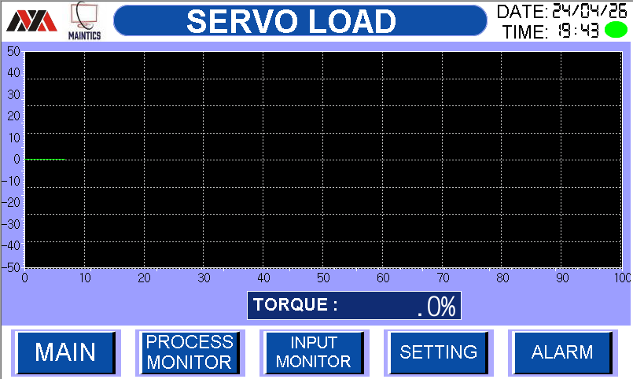
SERVO LOAD GRAPH
9. SERVO LOAD SCREEN

Slide 17
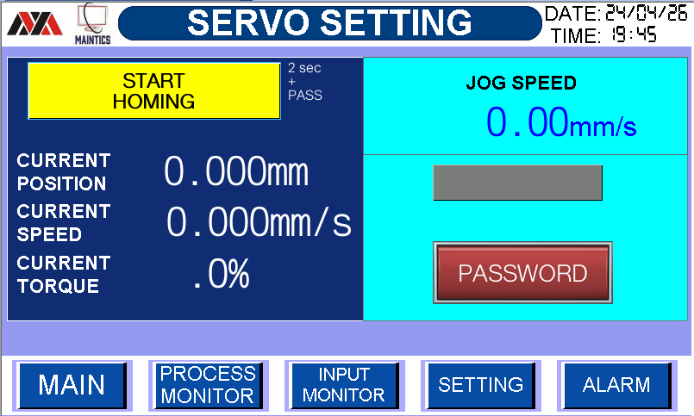
10. SERVO SETTING SCREEN
SERVO MOTOR HOMING STATUS
CURRENT OPSOTION (0.000MM)
CURRENT SPEED (0.000MM/s)
CURRENT TORQUE (0.0%)
SERVO MOTOR JOG SPEED
JOG SPEED MIN MAX
(0.01mm/s) (10.00mm/s)

Slide 18
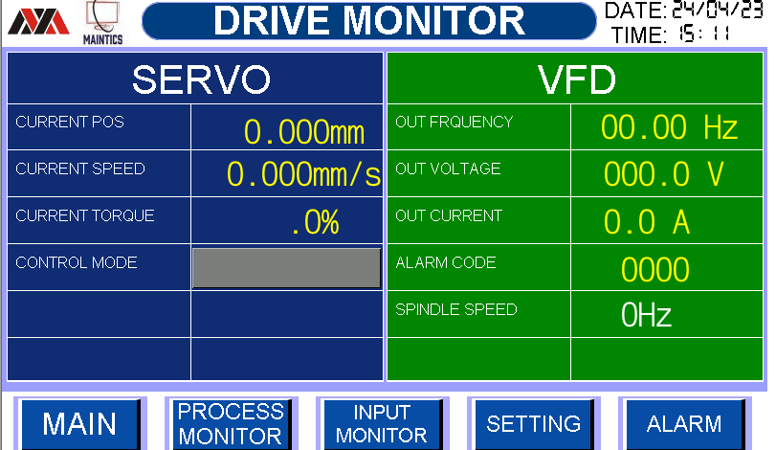

11. DRIVE MONITOR SCREEN
DRIVE MONITOR STATUS
Here you can monitor SERVO & VFD STATUS
Here you can change SPINDLE SPEED
MIN MAX
25Hz 60Hz

Slide 19
Electrical Drawings

Slide 20
Troubleshooting Guide

Slide 21
1. HMI ALARM GUIDE

Slide 22
2. MACHINE AUTO RUNNING FLOW
STOP
START PB
MACHINE HOME
NO
Check Reed Switch
X20, X22 if NO
YES
MACHINE AUTO
NO
Check Manual Screen
If NO
YES
MACHINE NORMAL
Check Alarm Screen
For any alarm reset alarm before if NO
NO (FAULT)
YES
AUTO RUNNING

Slide 23
BOM (BILL OF MATERIAL)

Slide 24
1. LIST OF ITEMS USED

